Slide 1


MINDFULNESS – PART II
Understanding Our Brain
Let's Find Out How Mindful You Really Are
A Guided Meditation Exercise for Kids (3min)
A Guided Meditation Exercise for Adults (5 min)
Tons of additional guided meditation exercises are available on YouTube & in your phone's app store.
Perfect 10 Breaths
Click on the speaker icon below for Part II- Intro

Slide 2

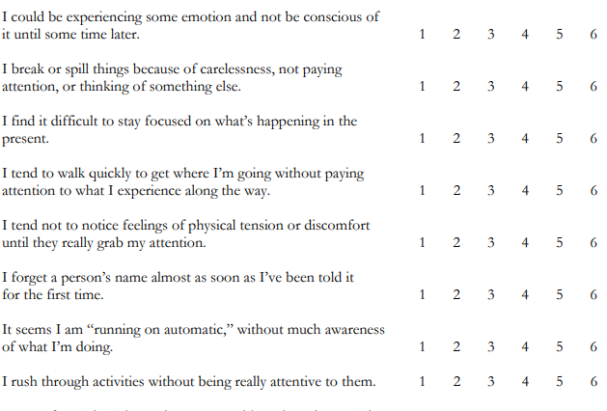
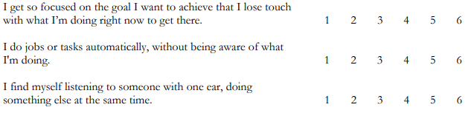
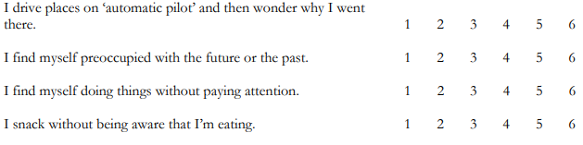
Day-to-Day Experiences Instructions
Below is a collection of statements about your everyday experience. Using the 1-6 scale below, please indicate how frequently or infrequently you currently have each experience. Please answer according to what really reflects your experience rather than what you think your experience should be. Please treat each item separately from every other item.
To score the scale, simply compute a mean of the 15 items. Higher scores reflect higher levels of dispositional mindfulness
Source: https://ppc.sas.upenn.edu/sites/default/files/mindfulnessscale.pdf
Return to Home

Slide 3
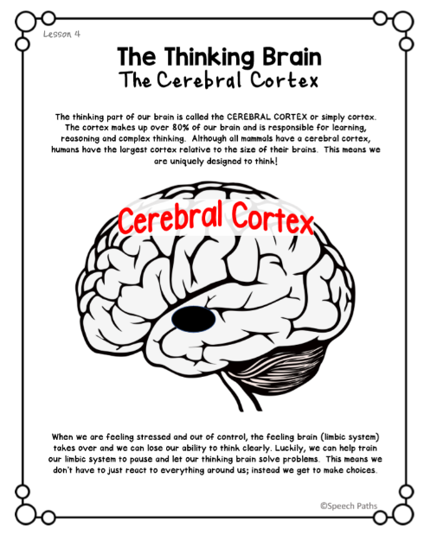
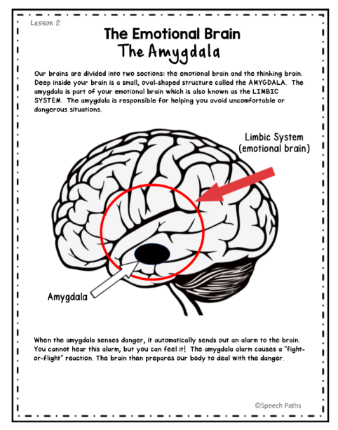
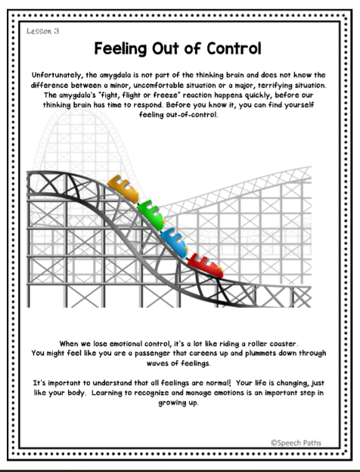
Return to Home

